Slide 1

Predicting Survival of Patients with Heart Failure.
Intended Audience: Healthcare Professionals, Medical Researchers, Students and Educators
DATASCI 207: Applied Machine Learning
Fall 2024
Jasmol Dhesi, Jason Chang, Kent Bourgoing, Sebastian Rosales, Sergey Nam
Notes:
Kent:
Intended Audience:
Healthcare professionals: Cardiologists, general practitioners, and nurses who treat or monitor heart failure patients.
Medical researchers: Individuals focused on clinical research, biostatistics, and epidemiology
Students and educators: Especially in medicine, nursing, public health, and data science fields

Slide 2

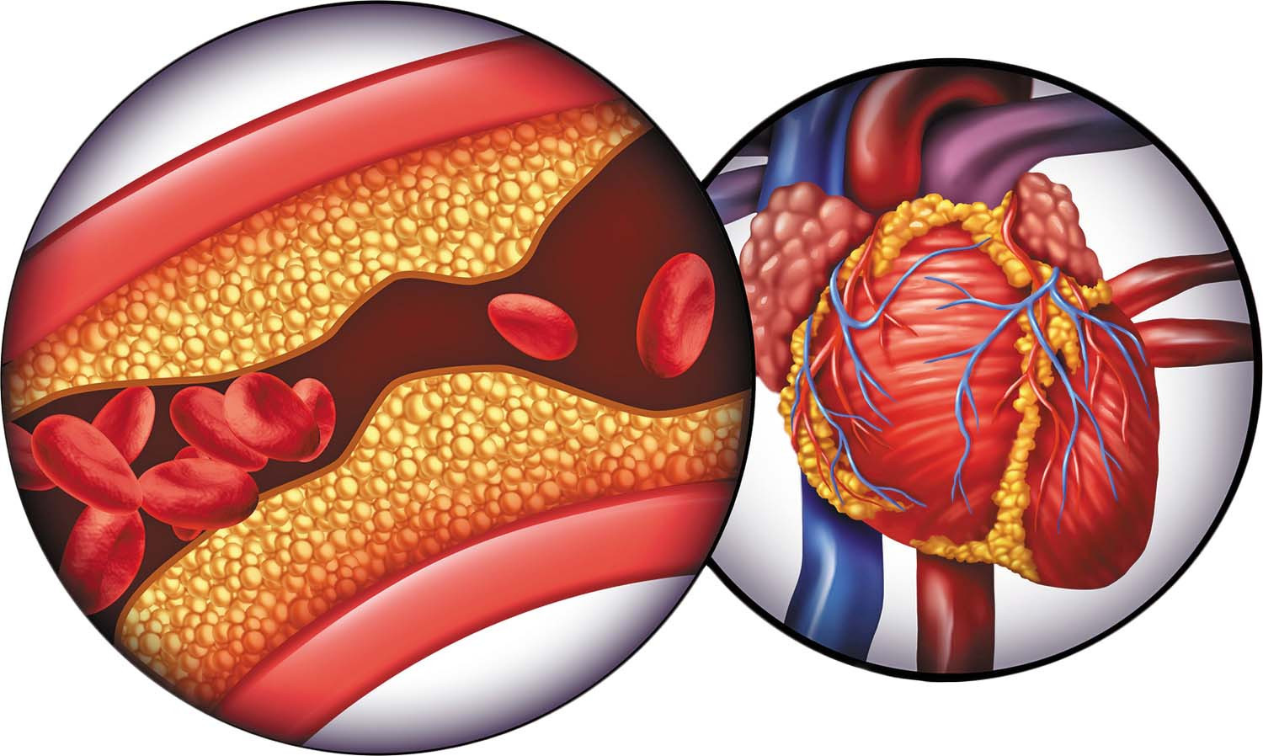
Motivation
Cardiovascular diseases, such as heart failure, are responsible approximately 17 million deaths worldwide each year (WHO, 2021).
Notes:
Kent:
Cardiovascular diseases (CVDs) are a group of disorders of the heart and blood vessels.
Key facts from the World Health Organization (WHO):
Cardiovascular diseases are the leading cause of death globally.
An estimated 17.9 million people died from CVDs in 2019, representing 32% of all global deaths.
Heart failure is a type of cardiovascular diseases which occurs when the heart muscle doesn't pump blood as well as it should. When this happens, blood often backs up and fluid can build up in the lungs, causing shortness of breath.
Complications of heart failure depend on your age, overall health and the severity of heart disease. They may include:
Kidney damage or failure
Liver damage
Sudden cardiac death

Slide 3

Motivation (cont.)
Medical Records:
Age
Sex
Smoker
Diabetes
Blood Pressure
Notes:
Kent:
Due to high number of recorded cases, we have a lot of research data to use in our study
Electronic Medical Records provide quantifiable data on patient symptoms, physical attributes, and clinical lab values.
Data from heart failure patient records can be analyzed to reveal patterns and correlations that may contribute to patient mortality.

Slide 4

Research Question
How accurately can machine learning models predict survival outcomes among heart failure patients based on clinical features extracted from electronic medical records?
Secondary Interest: How does the predictive accuracy of different machine learning algorithms compare in this context?
Notes:
Kent:
Main Research Question: How accurately can machine learning models predict survival outcomes among heart failure patients based on clinical features extracted from electronic medical records?
Secondary Research Question: How does the predictive accuracy of different machine learning algorithms compare in this context?

Slide 5





Dataset Overview
Source: 299 heart failure patients, Faisalabad, Pakistan (2015)
Collected from: Faisalabad Institute of Cardiology & Allied Hospital
Features: 13 clinical, demographic, and lifestyle factors
Notable Factors: Age, sex, ejection fraction, serum creatinine, anemia, diabetes, high blood pressure
Target: Survival outcome (died or survived)
Follow-up period: Average of 130 days
Demographics: 105 women, 194 men, ages 40-95
Notes:
Jasmol:
The dataset was sourced from the UCI Machine Learning Repository, initially used in a research study published by BMC. It originates from research conducted at the Faisalabad Institute of Cardiology and Allied Hospital in Faisalabad, Punjab, Pakistan.
The dataset contains medical records of 299 heart failure patients, gathered from the two hospitals in Faisalabad, Pakistan, between April and December 2015. It includes 13 clinical, demographic, and lifestyle features, such as age, sex, ejection fraction, serum creatinine, and indicators for conditions like anemia, diabetes, and high blood pressure. The target variable indicates whether each patient survived or died during an average follow-up period of 130 days. The dataset includes 105 women and 194 men, aged 40 to 95, all of whom experienced left ventricular systolic dysfunction.

Slide 6
Features Of Interest
Age: Older age increases risk for cardiovascular events and complicates heart failure management, making it a key mortality predictor.
Creatinine Phosphokinase (CPK): Elevated CPK signals muscle damage, including myocardial injury, which often indicates higher mortality risk.
Ejection Fraction (EF): Low EF reflects reduced cardiac efficiency and is strongly linked to heart failure severity, essential for assessing patient prognosis.
Platelets: Abnormal platelet levels can indicate cardiovascular complications like thrombosis, impacting survival rates in heart failure.
Serum Creatinine: Elevated levels indicate impaired kidney function, which is closely linked to poor outcomes in heart failure patients.
Serum Sodium: Low sodium (hyponatremia) often marks fluid imbalance and disease severity, impacting mortality risk.
Time (Days): Represents patient monitoring follow-up period, helping assess disease progression and survival trends over time.
Notes:
Jasmol: In selecting features to input into our model, we settled on the 7 features shown here: Age, creatine phosphokinase, ejection fraction, platelets, serum creatine, serum sodium, and time(days)
Currently looking at these feature as continuous series, however we’re considering quantization and converting them into categorical levels

Slide 7
Project Plan
Baseline Model
Majority Classification
Supervised ML Models
Unsupervised ML Models
Parametric ML Models
Non-Parametric ML Models
- K-Means Clustering
- Agglomerative Hierarchical Clustering
- Density-Based Spatial Clustering (DBSCAN)
- Gaussian Mixture Model (Data Augmentation)
- PCA/SVD*
- Logistic Regression
- Neural Network
- K-Nearest Neighbors (KNN)
- Decision Tree
- Majority Vote (Ensemble)
- Random Forest
- Bagging
- Gradient Boosting
- Adaptive Boosting (AdaBoost)
Notes:
Sergey:
Our project plan will cover two main types of machine learning: supervised and unsupervised.
We'll start simple with a baseline model using majority classification, then build up to more advanced models.
For supervised learning, we'll work with two groups of models: parametric ones like logistic regression and neural networks, and non-parametric ones like KNN and random forests. On the unsupervised side, we'll look at different ways to find patterns in data, including clustering methods and PCA.
This approach will help us figure out which models work best for our research.
We will assign team members to research each algorithm's applicability to our study and compare the findings.

Slide 8
Model Performance Metrics
Chosen Metric: Accuracy
Reason: Simple and suitable as our dataset is balanced between death and survival cases.
Alternative Metrics
Precision: Useful if false positives (predicting death when survival occurs) should be minimized.
Recall: Essential if catching all true death cases is critical, even with some false positives.
F1 Score: Balances precision and recall, ideal for imbalanced datasets.
AUC-ROC: Measures model’s ability to distinguish classes, helpful if class imbalance is present.
Notes:
Sergey:
The model performance metrics that we chose are as follows:
Accuracy which measures overall correct predictions, and is suitable for balanced datasets.
Precision focuses on minimizing false positives (like wrongly predicting death when survival occurs).
Recall, also called Sensitivity, ensures we catch all positive cases, which is crucial in medical contexts.
The F1 Score provides a balanced perspective by combining Precision and Recall into a single metric, making it particularly useful for imbalanced datasets.
AUC-ROC (Area Under the Curve - Receiver Operating Characteristic) evaluates how well the model distinguishes between classes across all possible classification thresholds, making it another good choice for imbalanced data.

Slide 9
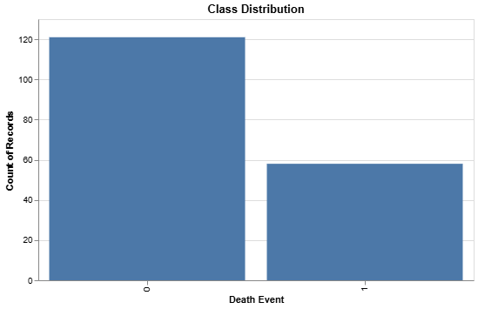
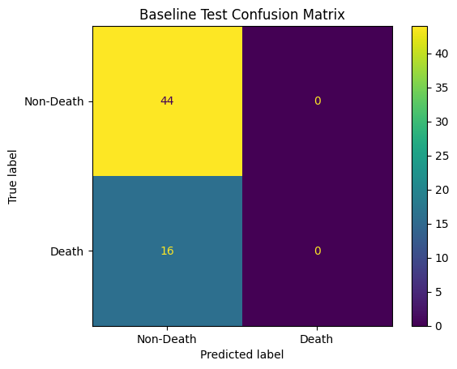
Baseline Model
Model: Majority Class Classifier
Split: 60/20/20 Train Test Validation Split
Within the training dataset we have a total of 179 records
121 non-deaths
58 deaths
Training Accuracy: 67.59%
Training Loss: 11.94
Validation Accuracy: 63.33%
Validation Loss: 13.51
Test Accuracy: 73.33%
Notes:
Sebastian:
So now we will talk about the results for our baseline model. As we mentioned before, the baseline model we decided to go with was the majority class classifier model. Essentially, what we did was utilize a 60/20/20 train test validation split and defined a model that would always predict whatever the majority class was within the training dataset. In the end, the training dataset had 179 records, 121 of which were non-death events and 58 were death events, and this is represented by the bar chart on the right. The model resulted in a training accuracy of around 67.59% with a loss of around 11.94. As for the validation, we got an accuracy of 63.33% with a loss of 13.51. In terms of its generalizability, we got a test accuracy of 73.33% which was higher than both the training and validation accuracy. However, there is a lot of randomness attached to this model and it could be we simply got lucky with this split. On top of that, from the confusion matrix on the right, we can see that on 16 occasions we predicted a non-death risk which means that these patients wouldn’t receive the necessary treatment to save their lives.

Slide 10
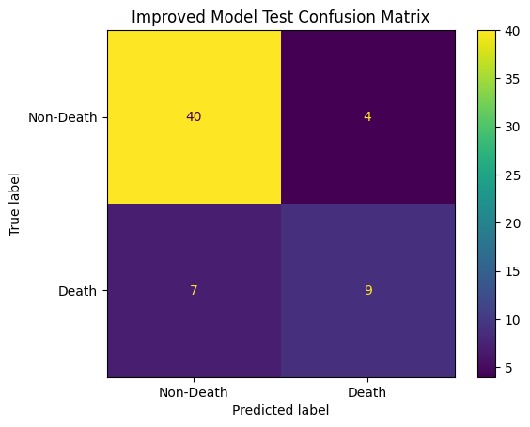
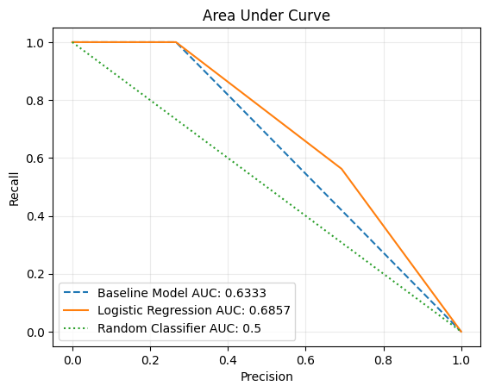
First Improved Model
Model: Logistic Regression (Decision Boundary of 0.5)
Training Accuracy: 83.24%
Training Loss: 0.38
Validation Accuracy: 78.33%
Validation Loss: 0.44
Test Accuracy: 81.67%
Test Recall: 56.25%
Test Precision: 69.23%
Notes:
Sebastian:
So we have started looking for improvements over our baseline model, and the first model we tried was a logistic regression with a decision boundary of 0.5. The results from this model were a significant improvement over the baseline as now the training accuracy has increased to about 83.24% and the loss has decreased to 0.38. Validation accuracy was still reasonable with 78.33% and a loss of 0.44. In terms of generalizability, we see that the model performed very well on the test data with an accuracy of 81.67%. However, after further inspection of the results, we found that the death class is still heavily confused. From the confusion matrix on the right, we can see that on 7 out of 16 occasions, the model predicted a death event as a non-death event and this can also be seen from the recall, as it is quite low at 56.25%. Ideally, we would like for our recall to be significantly higher since we believe that it is better to incorrectly predict a death and take precautions than to incorrectly predict a non-death and not give patients the appropriate care they need. From the Area Under the Curve plot, we can see that the logistic regression gives us a better trade-off than both the baseline and the random classifier, with an AUC of 0.6857. So in general, we can see that the logistic regression is an improvement over the baseline model but there is still a lot of room for improvement.

Slide 11
References
Data Set Link from UCI ML Repo: https://archive.ics.uci.edu/dataset/519/heart+failure+clinical+records
Davide Chicco, Giuseppe Jurman: "Machine learning can predict survival of patients with heart failure from serum creatinine and ejection fraction alone". BMC Medical Informatics and Decision Making 20, 16 (2020). https://doi.org/10.1186/s12911-020-1023-5
World Health Organization. (2021, June 11). Cardiovascular diseases (cvds). World Health Organization. https://www.who.int/news-room/fact-sheets/detail/cardiovascular-diseases-(cvds)#:~:text=Key%20facts%201%20Cardiovascular%20diseases%20%28CVDs%29%20are%20the,2019%2C%2038%25%20were%20caused%20by%20CVDs.%20More%20items
Mayo Clinic. (2023, April 20). Heart failure. https://www.mayoclinic.org/diseases-conditions/heart-failure/symptoms-causes/syc-20373142

